Slide 1
Chapter 6 Introduction to Flask

Slide 2
Content
Installation
Initialization
Routes and View Functions
A Complete Application
Dynamic Routes
Rendering Templates
Variables
Bootstrap Integration with Flask-Bootstrap
Custom Error Pages
Localization of Dates and Times with Flask-Moment
Web Forms
Configuration
Form Classes
HTML Rendering of Forms
Form Handling in View Functions
Redirects and User Sessions
Message Flashing

Slide 3
Installation
- Flask is a small framework by most standards—small enough to be called a “micro- framework,” and small enough that once you become familiar with it, you will likely be able to read and understand all of its source code.
- Flask has three main dependencies. The routing, debugging, and Web Server Gateway Interface (WSGI) subsystems come from Werkzeug; the template support is provided by Jinja2; and the command-line integration comes from Click.
- In this chapter, you will learn how to install Flask. The only requirement is a computer with Python installed.

Slide 4
Installing Python Packages with pip
To install Flask into the virtual environment, make sure the venv virtual environment is activated, and then run the following command:
(venv) $ pip install flask
When you execute this command, pip will not only install Flask, but also all of its dependencies. You can check what packages are installed in the virtual environment at any time using the pip freeze command:
(venv) $ pip freeze click==6.7 Flask==0.12.2 itsdangerous==0.24 Jinja2==2.9.6 MarkupSafe==1.0 Werkzeug==0.12.2
You can also verify that Flask was correctly installed by starting the Python inter‐ preter and trying to import it:
(venv) $ python
>>> import flask

Slide 5
Initialization
All Flask applications must create an application instance. The web server passes all requests it receives from clients to this object for handling, using a protocol called Web Server Gateway Interface (WSGI, pronounced “wiz-ghee”). The application instance is an object of class Flask, usually created as follows:
from flask import Flask
app = Flask(__name__)
The only required argument to the Flask class constructor is the name of the main module or package of the application. For most applications, Python’s name variable is the correct value for this argument.

Slide 6
Routes and View Functions
The most convenient way to define a route in a Flask application is through the app.route decorator exposed by the application instance. The following example shows how a route is declared using this decorator:
@app.route('/')
def index():
return '<h1>Hello World!</h1>'.
The following example uses app.add_url_rule() to register an index() function that is equivalent to the one shown previously:
def index():
return '<h1>Hello World!</h1>'
app.add_url_rule('/', 'index', index)

Slide 7
The following exam‐ ple defines a route that has a dynamic component:
@app.route('/user/<name>')
def user(name):
return '<h1>Hello, {}!</h1>'.format(name)
The dynamic components in routes are strings by default but can also be of different types. For example, the route /user/<int:id> would match only URLs that have an integer in the id dynamic segment, such as /user/123. Flask supports the types string, int, float, and path for routes. The path type is a special string type that can include forward slashes, unlike the string type.
return '<h1>Hello World!</h1>'

Slide 8
Development Web Server
To start the hello.py application from the previous section, first make sure the virtual environment you created earlier is activated and has Flask installed in it. For Linux and macOS users, start the web server as follows:
(venv) $ export FLASK_APP=hello.py
(venv) $ flask run
Serving Flask app "hello"
Running on http://127.0.0.1:5000/ (Press CTRL+C to quit)
For Microsoft Windows users, the only difference is in how the FLASK_APP environ‐ ment variable is set:
(venv) $ set FLASK_APP=hello.py
(venv) $ flask run
Serving Flask app "hello"
Running on http://127.0.0.1:5000/ (Press CTRL+C to quit)
Once the server starts up, it goes into a loop that accepts requests and services them. This loop continues until you stop the application by pressing Ctrl+C.
With the server running, open your web browser and type http://localhost:5000/ in the address bar.

Slide 9
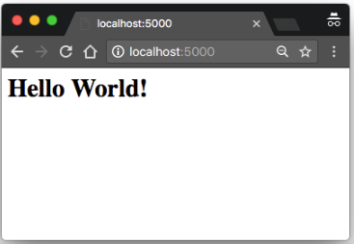
A Complete Application
from flask import Flask app = Flask(__name__) @app.route('/') def index(): return '<h1>Hello World!</h1>'
if __name__ == '__main__': app.run() or
if __name__ == '__main__': app.run(port=5000)

Slide 10
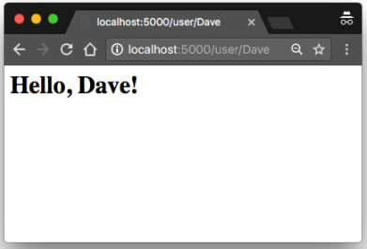
Dynamic Routes
from flask import Flask app = Flask(__name__) @app.route('/') def index(): return '<h1>Hello World!</h1>' @app.route('/user/<name>') def user(name): return '<h1>Hello, {}!</h1>'.format(name)

Slide 11
Application and Request Contexts
To avoid cluttering view functions with lots of arguments that may not always be needed, Flask uses contexts to temporarily make certain objects globally accessible. Thanks to contexts, view functions like the following one can be written:
from flask import request
@app.route('/')
def index():
user_agent = request.headers.get('User-Agent')
return '<p>Your browser is {}</p>'.format(user_agent)

Slide 12
Responses
When a view function needs to respond with a different status code, it can add the numeric code as a second return value after the response text. For example, the following view function returns a 400 status code, the code for a bad request error:
@app.route('/')
def index():
return '<h1>Bad Request</h1>', 400
The following example creates a response object and then sets a cookie in it:
from flask import make_response
@app.route('/')
def index():
response = make_response('<h1>This document carries a cookie!</h1>') response.set_cookie('answer', '42')
return response

Slide 13
A redirect response can be generated manually with a three-value return or with a response object, but given its frequent use, Flask provides a redirect() helper function that creates this type of response:
from flask import redirect
@app.route('/')
def index():
return redirect('http://www.example.com')
The following example returns status code 404 if the id dynamic argument given in the URL does not represent a valid user:
from flask import abort
@app.route('/user/<id>')
def get_user(id):
user = load_user(id)
if not user:
abort(404)
return '<h1>Hello, {}</h1>'.format(user.name)

Slide 14
Rendering Templates
By default Flask looks for templates in a templates subdirectory located inside the main application directory. For the next version of hello.py, you need to create the templates subdirectory and store the templates defined in the previous examples in it as index.html and user.html, respectively.
Example 3-1. templates/index.html: Jinja2 template
<h1>Hello World!</h1>
The response returned by the user() view function of Example 2-2 has a dynamic component, which is represented by a variable. Example 3-2 shows the template that implements this response.
Example 3-2. templates/user.html: Jinja2 template
<h1>Hello, {{ name }}!</h1>

Slide 15
Rendering Templates
By default Flask looks for templates in a templates subdirectory located inside the main application directory. For the next version of hello.py, you need to create the templates subdirectory and store the templates defined in the previous examples in it as index.html and user.html, respectively.
Example 3-3. hello.py: rendering a template from flask import Flask, render_template # ...
@app.route('/')
def index():
return render_template('index.html')
@app.route('/user/<name>')
def user(name):
return render_template('user.html', name=name)

Slide 16
Variables
The following are some more examples of variables used in templates:
<p>A value from a dictionary: {{ mydict['key'] }}.</p>
<p>A value from a list: {{ mylist[3] }}.</p>
<p>A value from a list, with a variable index: {{ mylist[myintvar] }}.</p>
<p>A value from an object's method: {{ myobj.somemethod() }}.</p>
Variables can be modified with filters, which are added after the variable name with a pipe character as separator. For example, the following template shows the name vari‐ able capitalized:
Hello, {{ name|capitalize }}

Slide 17
Bootstrap Integration with Flask-Bootstrap
Bootstrap is an open-source web browser framework from Twitter that provides user interface components that help create clean and attractive web pages that are compatible with all modern web browsers used on desktop and mobile platforms.
The extension is called Flask-Bootstrap, and it can be installed with pip:
(venv) $ pip install flask-bootstrap
Example 3-4. hello.py: Flask-Bootstrap initialization
from flask_bootstrap import Bootstrap
# ...
bootstrap = Bootstrap(app)

Slide 18
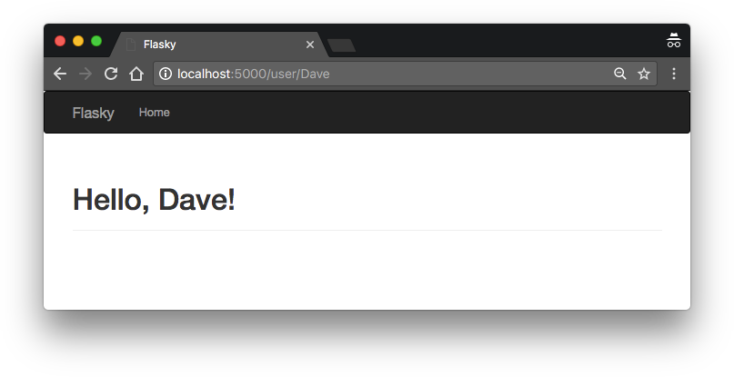
Example 3-5. templates/user.html: template that uses Flask-Bootstrap
{% extends "bootstrap/base.html" %}
{% block title %}Flasky{% endblock %}
{% block navbar %}
<div class="navbar navbar-inverse" role="navigation">
<div class="container">
<div class="navbar-header">
<button type="button" class="navbar-toggle"
data-toggle="collapse" data-target=".navbar-collapse">
<span class="sr-only">Toggle navigation</span>
<span class="icon-bar"></span>
<span class="icon-bar"></span>
<span class="icon-bar"></span>
</button>
<a class="navbar-brand" href="/">Flasky</a>
</div>
<div class="navbar-collapse collapse">
<ul class="nav navbar-nav">
<li><a href="/">Home</a></li>
</ul>
</div>
</div>
</div>
{% endblock %}
{% block content %}
<div class="container">
<div class="page-header">
<h1>Hello, {{ name }}!</h1>
</div>
</div>
{% endblock %}

Slide 19
Custom Error Pages
When you enter an invalid route in your browser’s address bar, you get a code 404 error page. Compared to the Bootstrap-powered pages, the default error page is now too plain and unattractive, and it has no consistency with the actual pages generated by the application.
Example 3-6. hello.py: custom error pages
@app.errorhandler(404)
def page_not_found(e):
return render_template('404.html'), 404
@app.errorhandler(500)
def internal_server_error(e):
return render_template('500.html'), 500
Error handlers return a response, like view functions, but they also need to return the numeric status code that corresponds to the error, which Flask conveniently accepts as a second return value.

Slide 20
Example 3-7. templates/base.html: base application template with navigation bar
{% extends "bootstrap/base.html" %}
{% block title %}Flasky{% endblock %}
{% block navbar %}
<div class="navbar navbar-inverse" role="navigation">
<div class="container">
<div class="navbar-header">
<button type="button" class="navbar-toggle"
data-toggle="collapse" data-target=".navbar-collapse">
<span class="sr-only">Toggle navigation</span>
<span class="icon-bar"></span>
<span class="icon-bar"></span>
<span class="icon-bar"></span>
</button>
<a class="navbar-brand" href="/">Flasky</a>
</div>
<div class="navbar-collapse collapse">
<ul class="nav navbar-nav">
<li><a href="/">Home</a></li>
</ul>
</div>
</div>
</div>
{% endblock %}
{% block content %}
<div class="container">
{% block page_content %}{% endblock %}
</div>
{% endblock %}

Slide 21
Example 3-8. templates/404.html: custom code 404 error page using template inheritance
{% extends "base.html" %}
{% block title %}Flasky - Page Not Found{% endblock %}
{% block page_content %}
<div class="page-header">
<h1>Not Found</h1>
</div>
{% endblock %}
Example 3-9. templates/user.html: simplified page template using template inheritance
{% extends "base.html" %}
{% block title %}Flasky{% endblock %}
{% block page_content %}
<div class="page-header">
<h1>Hello, {{ name }}!</h1>
</div>
{% endblock %}

Slide 22
Example 3-10 shows how the application can include a favicon.ico icon in the base template for browsers to show in the address bar.
Example 3-10. templates/base.html: favicon definition
{% block head %}
{{ super() }}
<link rel="shortcut icon" href="{{ url_for('static', filename='favicon.ico') }}" type="image/x-icon">
<link rel="icon" href="{{ url_for('static', filename='favicon.ico') }}" type="image/x-icon">
{% endblock %}

Slide 23
Localization of Dates and Times with Flask-Moment
Handling of dates and times in a web application is not a trivial problem when users work in different parts of the world.
There is an excellent open source library written in JavaScript that renders dates and times in the browser called Moment.js. Flask-Moment is an extension for Flask appli‐ cations that makes the integration of Moment.js into Jinja2 templates very easy. Flask- Moment is installed with pip:
(venv) $ pip install flask-moment

Slide 24
The extension is initialized in a similar way to Flask-Bootstrap. The required code is shown in Example 3-11.
Example 3-11. hello.py: initializing Flask-Moment
from flask_moment import Moment moment = Moment(app)
Example 3-12. templates/base.html: importing the Moment.js library
{% block scripts %}
{{ super() }}
{{ moment.include_moment() }}
{% endblock %}
To work with timestamps, Flask-Moment makes a moment object available to tem‐ plates. Example 3-13 demonstrates passing a variable called current_time to the tem‐ plate for rendering.
Example 3-13. hello.py: adding a datetime variable
from datetime import datetime @app.route('/')
def index():
return render_template('index.html',
current_time=datetime.utcnow())

Slide 25
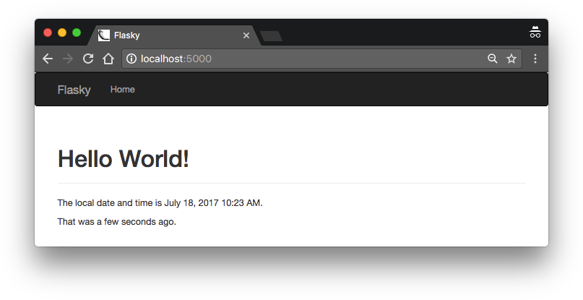
Example 3-14 shows how this current_time template variable is rendered.
Example 3-14. templates/index.html: timestamp rendering with Flask-Moment
<p>The local date and time is {{ moment(current_time).format('LLL') }}.</p>
<p>That was {{ moment(current_time).fromNow(refresh=True) }}</p>
The format('LLL') function renders the date and time according to the time zone and locale settings in the client computer. The argument determines the rendering style, from 'L' to 'LLLL' for four different levels of verbosity. The format() function can also accept a long list of custom format specifiers.
Figure 3-3 shows how the http://localhost:5000/ route looks after the two timestamps are added to the index.html template.

Slide 26
Web Forms
Flask-WTF and its dependencies can be installed with pip:
(venv) $ pip install flask-wtf
Configuration
Example 4-1. hello.py: Flask-WTF configuration
app = Flask(__name__)
app.config['SECRET_KEY'] = 'hard to guess string'

Slide 27
Form Classes
Example 4-2 shows a simple web form that has a text field and a submit button.
Example 4-2. hello.py: form class definition
from flask_wtf import FlaskForm
from wtforms import StringField, SubmitField
from wtforms.validators import DataRequired
class NameForm(FlaskForm):
name = StringField('What is your name?', validators=[DataRequired()]) submit = SubmitField('Submit')

Slide 28
HTML Rendering of Forms
Form fields are callables that, when invoked from a template, render themselves to HTML. Assuming that the view function passes a NameForm instance to the template as an argument named form, the template can generate a simple HTML form as follows:
<form method="POST">
{{ form.hidden_tag() }}
{{ form.name.label }} {{ form.name() }}
{{ form.submit() }}
</form>
Any key‐ word arguments added to the calls that render the fields are converted into HTML attributes for the field—so, for example, you can give the field id or class attributes and then define CSS styles for them:
<form method="POST">
{{ form.hidden_tag() }}
{{ form.name.label }} {{ form.name(id='my-text-field') }}
{{ form.submit() }}
</form>
Using Flask-Bootstrap, the previous form can be rendered as follows:
{% import "bootstrap/wtf.html" as wtf %}
{{ wtf.quick_form(form) }}

Slide 29
Example 4-3. templates/index.html: using Flask-WTF and Flask-Bootstrap to render a form
{% extends "base.html" %}
{% import "bootstrap/wtf.html" as wtf %}
{% block title %}Flasky{% endblock %}
{% block page_content %}
<div class="page-header">
<h1>Hello, {% if name %}{{ name }}{% else %}Stranger{% endif %}!</h1>
</div>
{{ wtf.quick_form(form) }}
{% endblock %}

Slide 30
Form Handling in View Functions
In the new version of hello.py, the index() view function will have two tasks. First it will render the form, and then it will receive the form data entered by the user. Example 4-4 shows the updated index() view function.
Example 4-4. hello.py: handle a web form with GET and POST request methods
@app.route('/', methods=['GET', 'POST'])
def index():
name = None
form = NameForm()
if form.validate_on_submit(): name = form.name.data form.name.data = ''
return render_template('index.html', form=form, name=name)

Slide 31
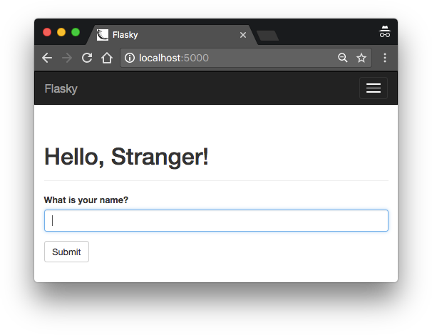
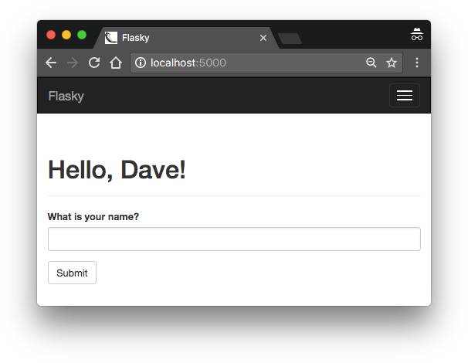
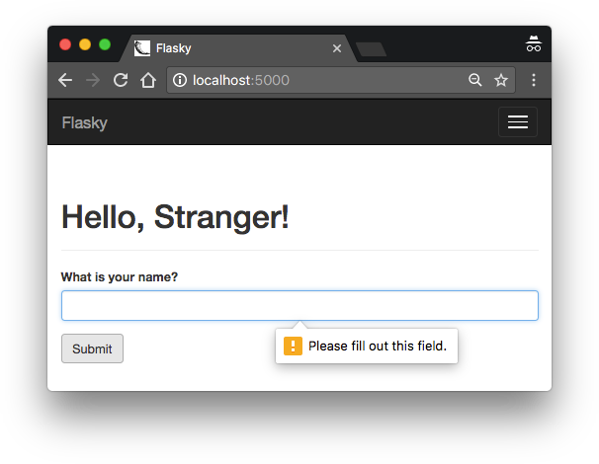
Figure 4-1. Flask-WTF web form
Figure 4-2. Web form after submission
Figure 4-3. Web form after failed validator

Slide 32
Redirects and User Sessions
Example 4-5 shows a new version of the index() view function that implements redi‐ rects and user sessions.
Example 4-5. hello.py: redirects and user sessions
from flask import Flask, render_template, session, redirect, url_for @app.route('/', methods=['GET', 'POST'])
def index():
form = NameForm()
if form.validate_on_submit(): session['name'] = form.name.data return redirect(url_for('index'))
return render_template('index.html', form=form, name=session.get('name'))
In the previous version of the application, a local name variable was used to store the name entered by the user in the form. That variable is now placed in the user session as session['name'] so that it is remembered beyond the request.

Slide 33
Message Flashing
Flask includes this functionality as a core feature. Example 4-6 shows how the
flash() function can be used for this purpose.
Example 4-6. hello.py: flashed messages
from flask import Flask, render_template, session, redirect, url_for, flash @app.route('/', methods=['GET', 'POST'])
def index():
form = NameForm()
if form.validate_on_submit(): old_name = session.get('name')
if old_name is not None and old_name != form.name.data: flash('Looks like you have changed your name!')
session['name'] = form.name.data
return redirect(url_for('index'))
return render_template('index.html',
form = form, name = session.get('name'))

Slide 34
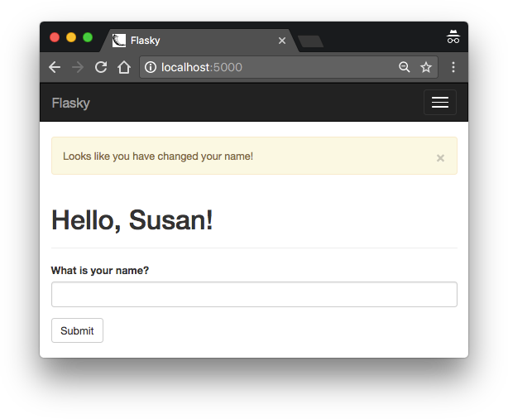
Example 4-7. templates/base.html: rendering of flashed messages
{% block content %}
<div class="container">
{% for message in get_flashed_messages() %}
<div class="alert alert-warning">
<button type="button" class="close" data-dismiss="alert">&times;</button>
{{ message }}
</div>
{% endfor %}
{% block page_content %}{% endblock %}
</div>
{% endblock %}
In this example, messages are rendered using Bootstrap’s alert CSS styles for warning messages (one is shown in Figure 4-4).

